Slide 1
Capstone Project PPT
AIML Online May19 Group7A
Amit Kumar Gupta
Deepali Chandratre Godbole
Leela Desai
Micheal Philomine Raja
Poonam Kushwaha
Uma Satya Vani Nagandala

Slide 2
Problem Statement
Need to build an automatic ticket assigner by analyzing the text
Steps Involved
Exploratory Data Analysis
Data Cleaning and Feature Vector Generation
Model Fitting and Hyper-Parameter Tuning
Word Embedding to boost Model Performance

Slide 3
Flowchart of Ticketing Process (1/2)
A ticket is raised. Data will consist of Short Description, Description and Caller details
If Size of Description is greater than that of Short description?
No
Description is replaced by short description
Yes
Description is converted to string and is taken up for further processing
Description is converted to string and is taken up for further processing
Description is converted to lower case
Following is removed form Description: Line breaks, ‘\n’,Emails, Underscore, Punctuation, Additional Whitespaces, Digits other than with format Job_<jobnumber>,Stopwords, Caller names

Slide 4
Flowchart of Ticketing Process (2/2)
Extract bigrams and trigrams
Determine TF-IDF for unigrams, bigrams, trigrams
Based on TF-IDF values, transform unigrams, bigrams and trigrams to feature vectors
Load word embedding
Create Embedding Matrix
Pass generated vector through pre-trained model
Output

Slide 5




Exploratory Data Analysis
The data consists of 8500 rows and 4 columns
The 4 columns are below:
Short Description: Short summary of ticket
Description: Description of the issue
Caller: The person who raised the ticket
Assignment Group: Group to which ticket is assigned

Slide 6
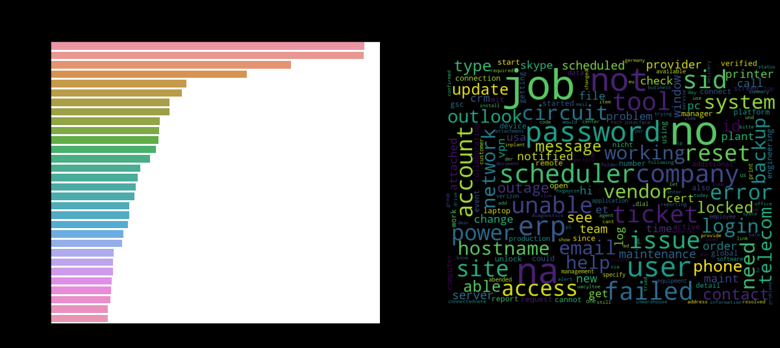
Exploratory Data Analysis
After data analysis and data cleaning, we got below word cloud. The maximum representation is from group 0.
Data cloud before cleaning
Data cloud after cleaning

Slide 7
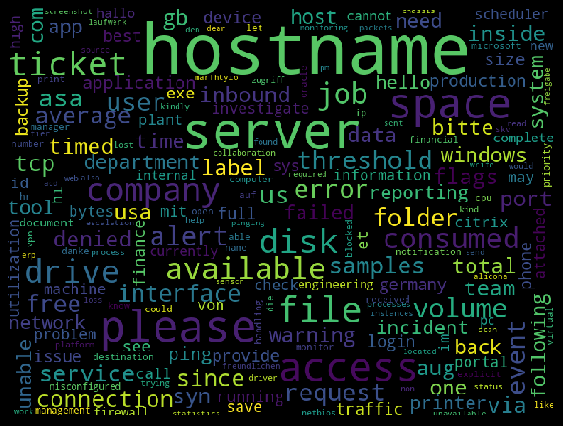
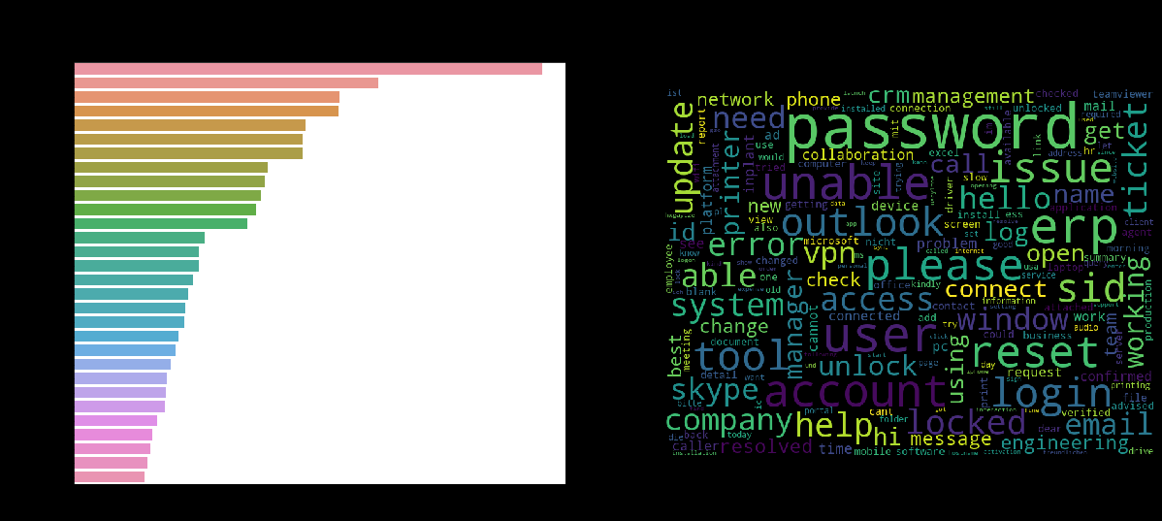
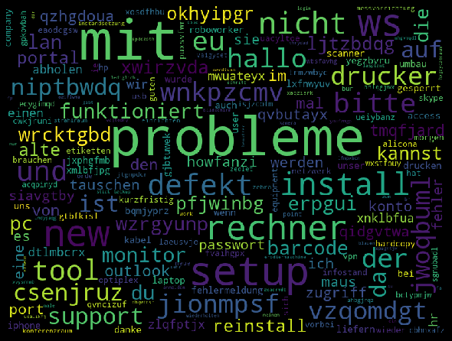

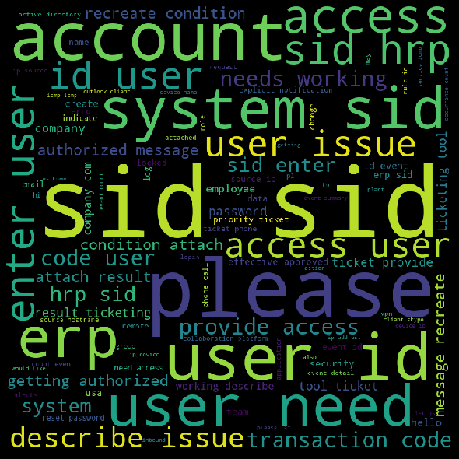

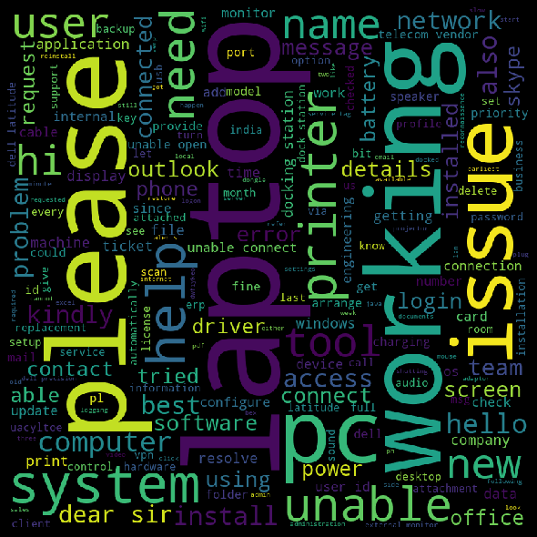
Exploratory Data Analysis
Group 24
Group 12
Group 0
Group 8
Group 2
Group 8
Group 19
Group 9

Slide 8
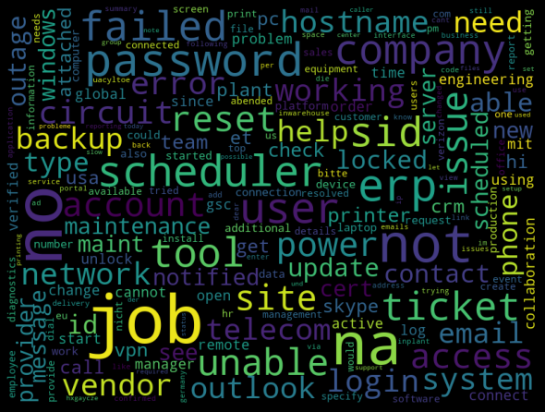
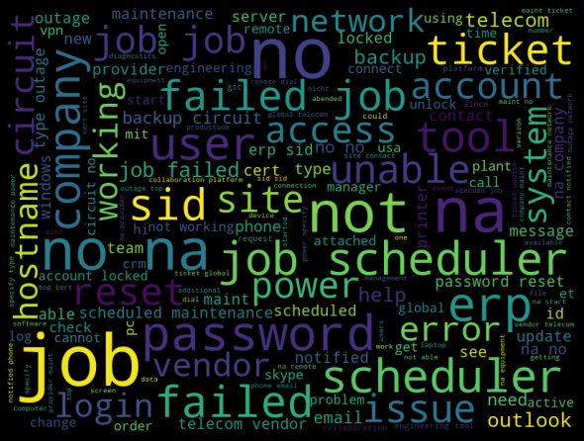
N-Gram Analysis (1/2)
Word cloud for unigram
Word cloud for unigram + bigram
Total no. of unigram without stop-words: 14520
Size of unigram vocab after cleaning: 3049
Size of unigram tokens based on TF-IDF Frequency: 2659
Total no. of bigram without stop-words: 61580
Size of bigram vocab after cleaning: 30368
Size of bigram tokens based on TF-IDF Frequency: 26692

Slide 9

N-Gram Analysis (2/2)
Word cloud for unigram + bigram + trigrams
Total no. of trigram without stop-words: 75257
Size of trigram vocab after cleaning: 38857
Size of trigram tokens based on TF-IDF Frequency: 36155

Slide 10

Machine Learning Models
Machine Learning Models in the project
Naïve Bayes
Logistic Regression
SVM Classifier
Unigram tf-idf score | bigram tf-idf score | triigram tf-idf score
51.292 | 50.0 | 49.815
Unigram tf-idf score | bigram tf-idf score | triigram tf-idf score
53.506 | 51.292 | 51.107
Unigram tf-idf score | bigram tf-idf score | triigram tf-idf score
52.952 | 51.292 | 51.107
This column provides the short description of the issue.
This column provides the short description of the issue.
This column provides the detailed summary of the issue.
Random Forest
XG Boost
KNN
Unigram tf-idf score | bigram tf-idf score | triigram tf-idf score
54.982 | 56.273 | 55.535
Unigram tf-idf score | bigram tf-idf score | triigram tf-idf score
54.244 | 53.506 | 54.059
This column provides the short description of the issue.
This column tells us about the person who raised the ticket.
This column tells us about the group to which ticket is issued
Unigram tf-idf score | bigram tf-idf score | triigram tf-idf score
52.214 | 50.738 | 50.185
Random Forest score after performing parameter hyper-tuning

Slide 11
Deep Learning Models
Simple Neural Network
Unigram tf-idf score | bigram tf-idf score | triigram tf-idf score
50.526 | 52.105 | 53.333
This column provides the short description of the issue.
Regularization Loss
callback
Batch normalization
Dense Layer
Dropout
Improved score of
Simple Neural Network
Unigram tf-idf score | bigram tf-idf score | triigram tf-idf score
53.875 | 55.351 | 54.613
This column provides the short description of the issue.

Slide 12

Embedding
Embedding
Considered
ELMO
Embedding
Used
BERT
FAST TEXT
FAST TEXT
Word2Vec
Word2Vec
GloVe
GloVe

